Slide 1
Data Analytics
Arcot (Raja) Rajasekar
rajasekar@unc.edu
Unit #03

Slide 2
Unit #03
Performance Validation of Data Analytics

Slide 3
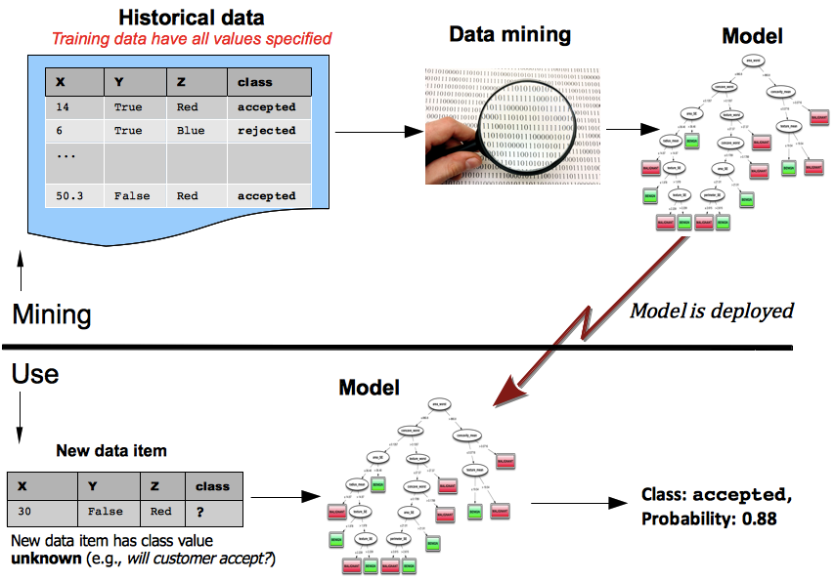
Two Phases of Data Analytics
(training phase)
(application phase)
Image from “Data Science for Business”, Provost and Fawcett, 2013

Slide 4
Generalization & Overfitting
Generalization is the property of a model, whereby the model is accurate for data that were not used to build the model.
  Generalize beyond input data instances
Overfitting is the tendency of data mining procedures to tailor models to the training data, at the expense of generalization to previously unseen data points.
  Curbing generalization
You want a model which is a balance between fitting and general

Slide 5
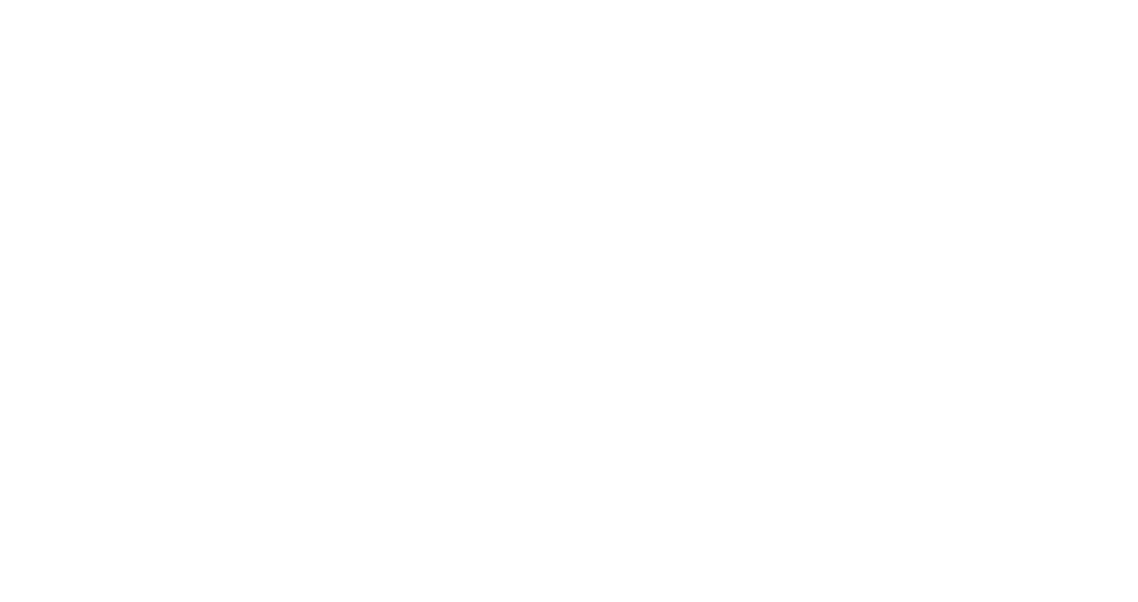
Two Measurement Concepts:
Training a Simple Tree
Correctly classified instances for training data – 87.5%
Training Accuracy or
In-sample Accuracy
# | Age>60 | Buy
1 | 0 | No
2 | 0 | No
3 | 0 | No
4 | 0 | Yes
5 | 1 | Yes
6 | 1 | Yes
7 | 1 | Yes
8 | 1 | Yes
Incorrect
Classification
All customers
Age>60,”1”
MODEL
Age>60,”0”
YES
No

Slide 6
Two Measurement Concepts:
Validating a Simple Tree
# | Age>60 | Buy
1 | 0 | No
2 | 0 | No
3 | 0 | No
4 | 0 | Yes
5 | 1 | Yes
6 | 1 | Yes
7 | 1 | Yes
8 | 1 | Yes
Training Accuracy– 87.5%
Correctly classified instances for “external” data – 75%
APPLICATION
# | Age>60 | Buy
9 | 0 | Yes
10 | 0 | No
11 | 0 | No
12 | 0 | No
13 | 1 | Yes
14 | 1 | Yes
15 | 1 | Yes
16 | 0 | Yes
Incorrect
Classification
All customers
Age>60,”1”
MODEL
Age>60,”0”
YES
No
Usage/Validation Accuracy or Out-of-Sample Accuracy

Slide 7
Model Performance
How do I know that my (supervised) model is any good?
With powerful, flexible algorithms searching for patterns or models, there is a serious danger of overfitting.
  overfitting sometimes is a difficult concept
  generally the idea is that “if you look hard enough you’ll find something” even if it does not generalize beyond the particular training data.
Overfitting will increase training accuracy but will also reduce validation (testing) accuracy
  Gives rise to bad predictions by the model
How do we know we are overfitting?
  Remember that overfitting is known during usage phase(after-the-fact)

Slide 8
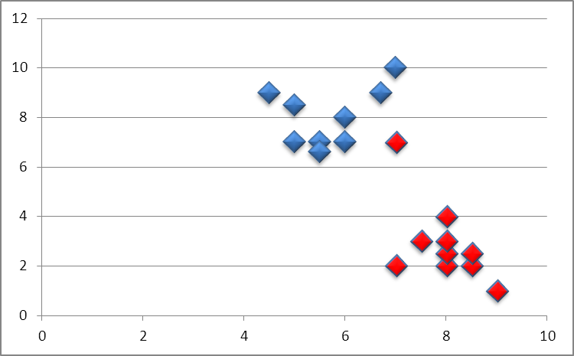
Overfitting? (Linear Discriminant)
A
B
# Past
Purchases
Telephone calls

Slide 9
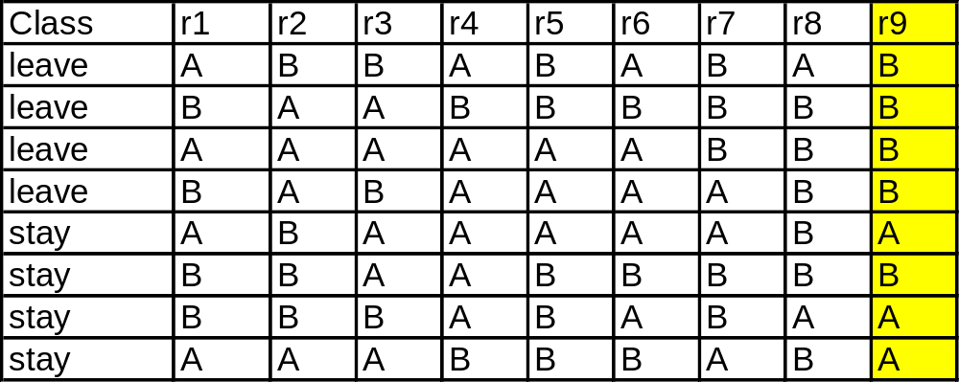
Another Example: With 9 random variables…
J48 unpruned tree
------------------
r9 = B
| r2 = B
| | r1 = A: leave (1.0)
| | r1 = B: stay (1.0)
| r2 = A: leave (3.0)
r9 = A: stay (3.0)
Number of Leaves : 4
Size of the tree : 7
Time taken to build model: 0 seconds
=== Evaluation on training set ===
=== Summary ===
Correctly Classified Instances 8 100 %
r9 just misses 1:
r9 = A => stay
r9 = B => leave
Generalization: 87.5% accuracy

Slide 10
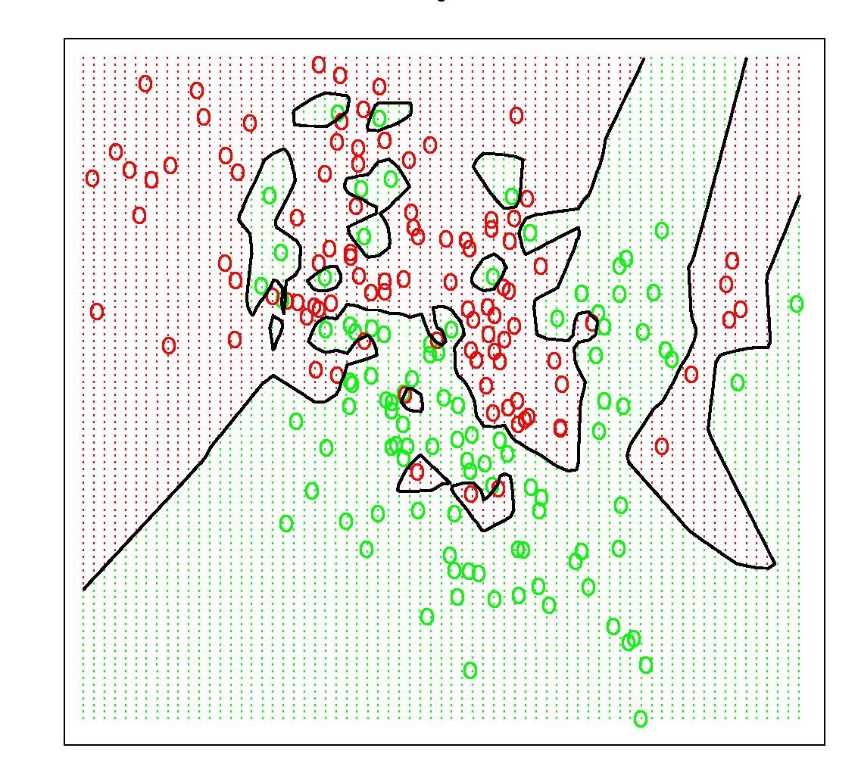
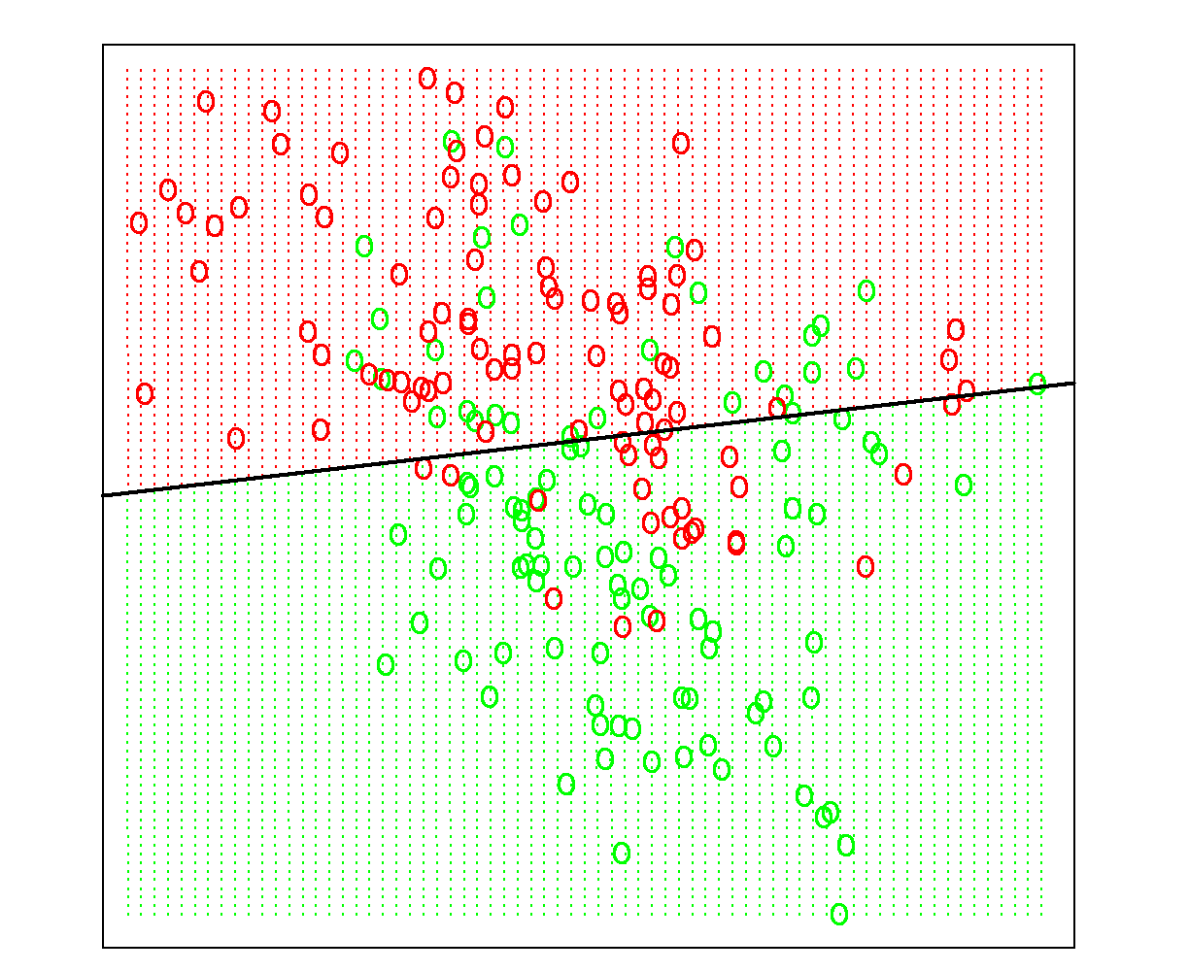
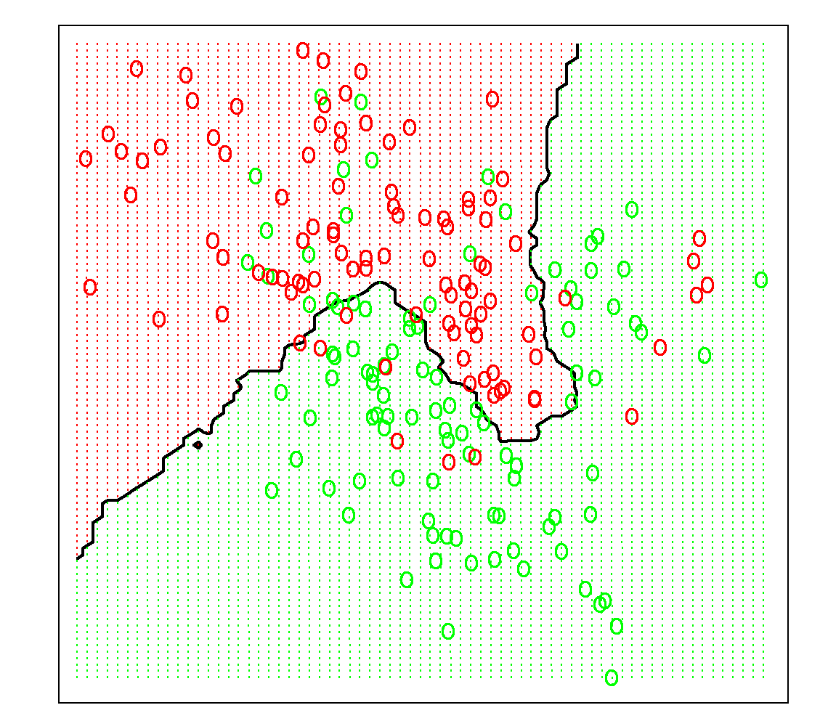
Model complexity via geometric interpretation
How can we judge whether our modeling has overfit?
3 models
(which do you prefer?)
Notes:
kNN with 15 and 1 neighbor.

Slide 11
Checking for Overfitting
Evaluation on training data is not useful for assessing how well the model generalizes to unseen cases
  Training Accuracy does not indicate Usage Accuracy
One idea – Hold Out Validation
  Split Input into training and test data
  “Hold out” some data for which you know the value of the target variable, but which will not be used during model building phase
  Test model performance using the holdout data.
  A form of a “Lab test” for generalization/overfitting performance

Slide 12
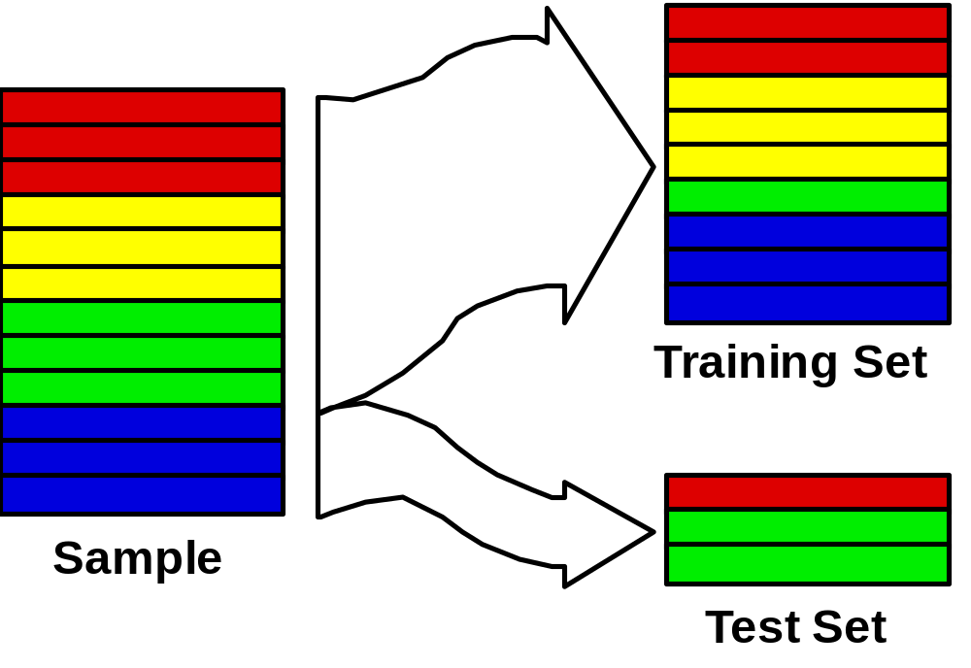
Hold-out validation: simple holdout set
Partition data into training set and test set
In some domains it makes sense to partition temporally
training set before time t,
test set after time t
challenges: 1) what if by accident you selected a particularly easy/hard test set?
2) do you have an idea of the variation in model accuracy due to training?

Slide 13
Challenge & Response
Challenges: 1) what if by accident you selected a particularly easy/hard test set?
2) do you have an idea of the variation in model accuracy due to training?
When dividing input dataset into training and testing:
  What can be the ratio of the division?
  Should the training set be larger or smaller?
    Training set should be larger so that we get a good Model
    Normal ratio 90:10 or 80:10 or even larger
  Picking a different subset for Training “may” lead to different Models
    If data is not homogenous or non-uniformly distributed
  Which part of the input should become test set?
    Temporal partitioning may not be good.
    Example Use Jan to Oct for Training and Nov & Dec to Testing
    But can cause problem – Holiday Sales, Winter, Year-end
    Shuffle the input data and pick the last 10% for testing
    Randomly choose the Test set from the whole dataset
  A better way is Cross validation

Slide 14
Types of Cross Validation
K-Fold Cross Validation
Leave-One-Out Cross Validation
Nested HoldOut

Slide 15
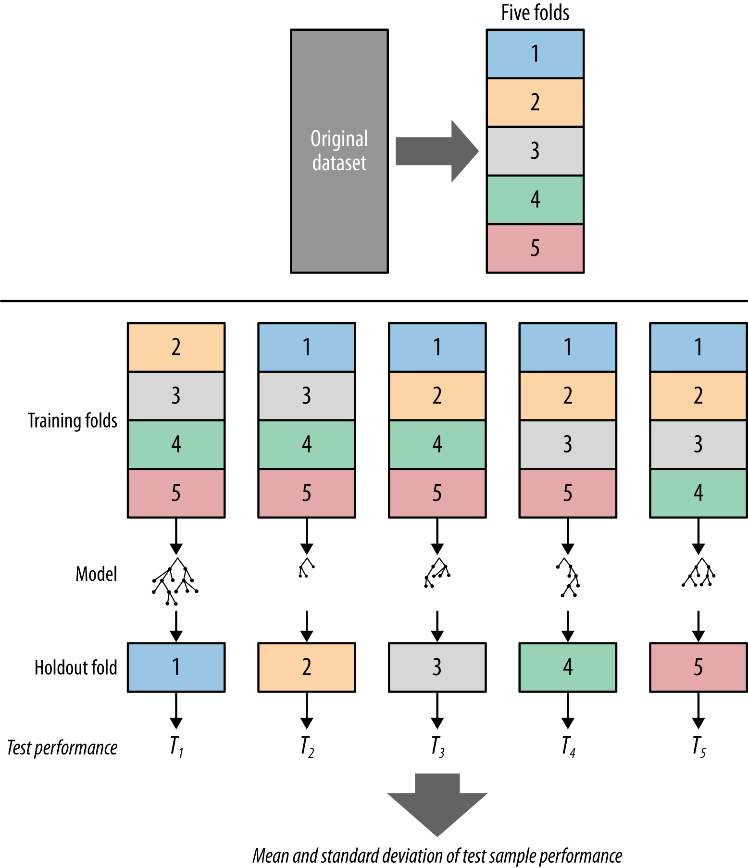
K-Fold Cross-validation (CV)
Hint; May shuffle
before folding

Slide 16
Nested Holdout – Three way Split
Don’t want to overfit the test data!
Nested folds – fold the training set
  Called nested training set and validation set
Controls complexity
  When choosing models, features,
  complexity parameters, etc.
nested training data
split training
fold again
validation data
can run a (nested) holdout (or CV) on the training set, and make choices without examining test set.
when choices all are made, then test on test set
this “nested” test set is often called the “validation” set (to differentiate from the final test set).
save this for later

Slide 17
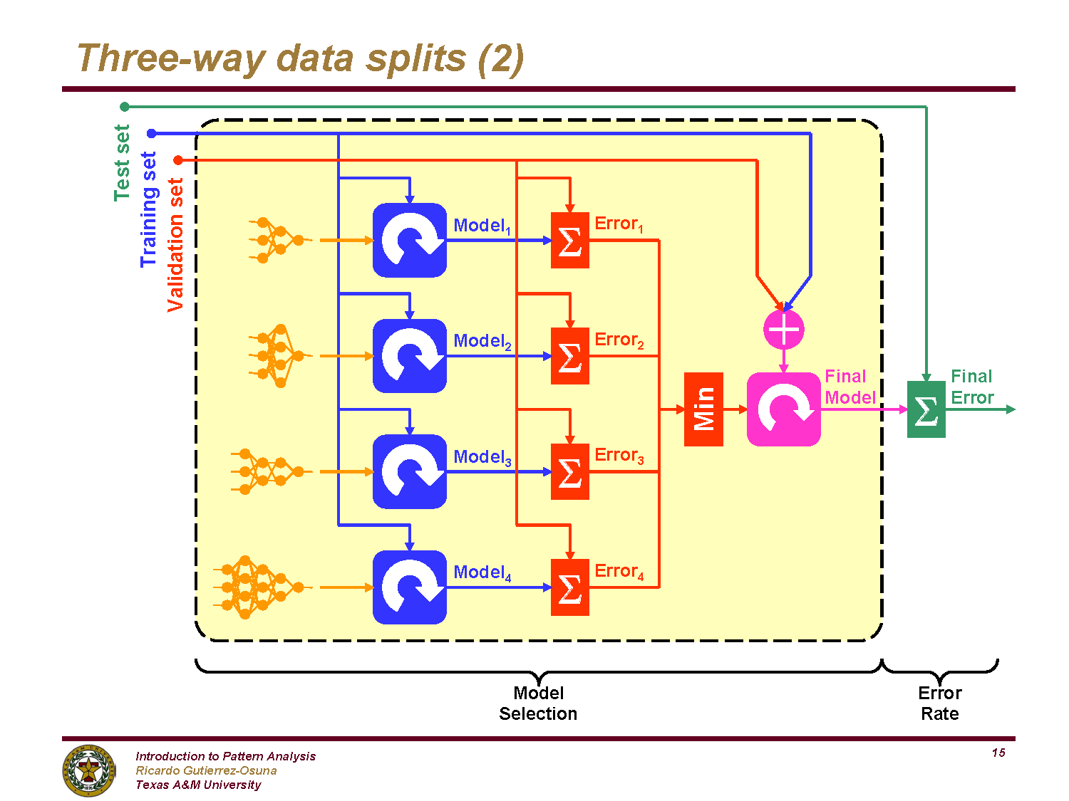

Slide 18
Problem: Small Input Data
What if dataset size is small
Statistically unviable
Standard error
  Deviation – sampling distribution
Standard error is related to the second derivative of the “likelihood”
  assumes sufficiently large sample
How does shape of the distribution curve affect the outcome:
  Means and Variance?
  odds ratio?
  ln(odds ratio)?
  B-coefficient from simple linear regression?
  Beta coefficient from logistic regression?

Slide 19
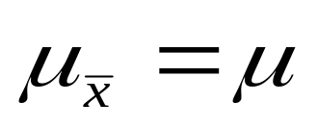
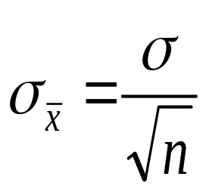
The Central Limit Theorem:
If all possible random samples, each of size n, are taken from any population with a mean μ and a standard deviation σ, the sampling distribution of the sample means (averages) will:
1. have mean:
2. have standard deviation:
3. be approximately normally distributed regardless of the shape of the parent population (normality improves with larger n)
This shows that random sampling is good.
Use this to grow the sample dataset when data size is small
Notes:
It turns out that if you were to go out and sample many, many times, most sample statistics that you could calculate would follow a normal distribution.
What are the 2 parameters (from last time) that define any normal distribution?
Remember that a normal curve is characterized by two parameters, a mean and a variability (SD)
What do you think the mean value of a sample statistic would be? The standard deviation?
Remember standard deviation is natural variability of the population
Standard error can be standard error of the mean or standard error of the odds ratio or standard error of the difference of 2 means, etc. The standard error of any sample statistic.

Slide 20
The Bootstrap Mechanism
Make no assumptions about the underlying distribution in the population
Randomly sample instances from data
Sample with replacement
  Every instance has an equal chance of being selected (=1/n)
  Same instance can be sampled multiple times
Create a larger dataset by combining drawn samples to the original dataset

Slide 21
Sampling with replacement
Original sample of n=6 observations.
Possible new samples:
A
B
C
D
E
F
A
A
A
D
C
C
B
A
C
E
Re-sample with replacement
D
C
B
C
D
F
E
F
**What’s the probability of each of these particular samples discounting order?

Slide 22
Unit Summary
Model Performance
  Training & Usage Accuracy
  Generalization & Overfitting
Validation
  Domain Knowledge validation
  Holdout Validation
  Cross Validation (different types)
  Three Way Splits
Sampling to improve model performance
  Bootstrap
  Note: Cross Validation and Bootstrap can be used together to improve performance and to evaluate to find best model

